Slide 1
Management of Fever, Anaemia, and Malaria in Children
Follow along on Twitter!
@NMEPNigeria #NigeriaMIS
@INS_cameroun #CameroonMIS #CamerounEIP
Notes:
T

Slide 2
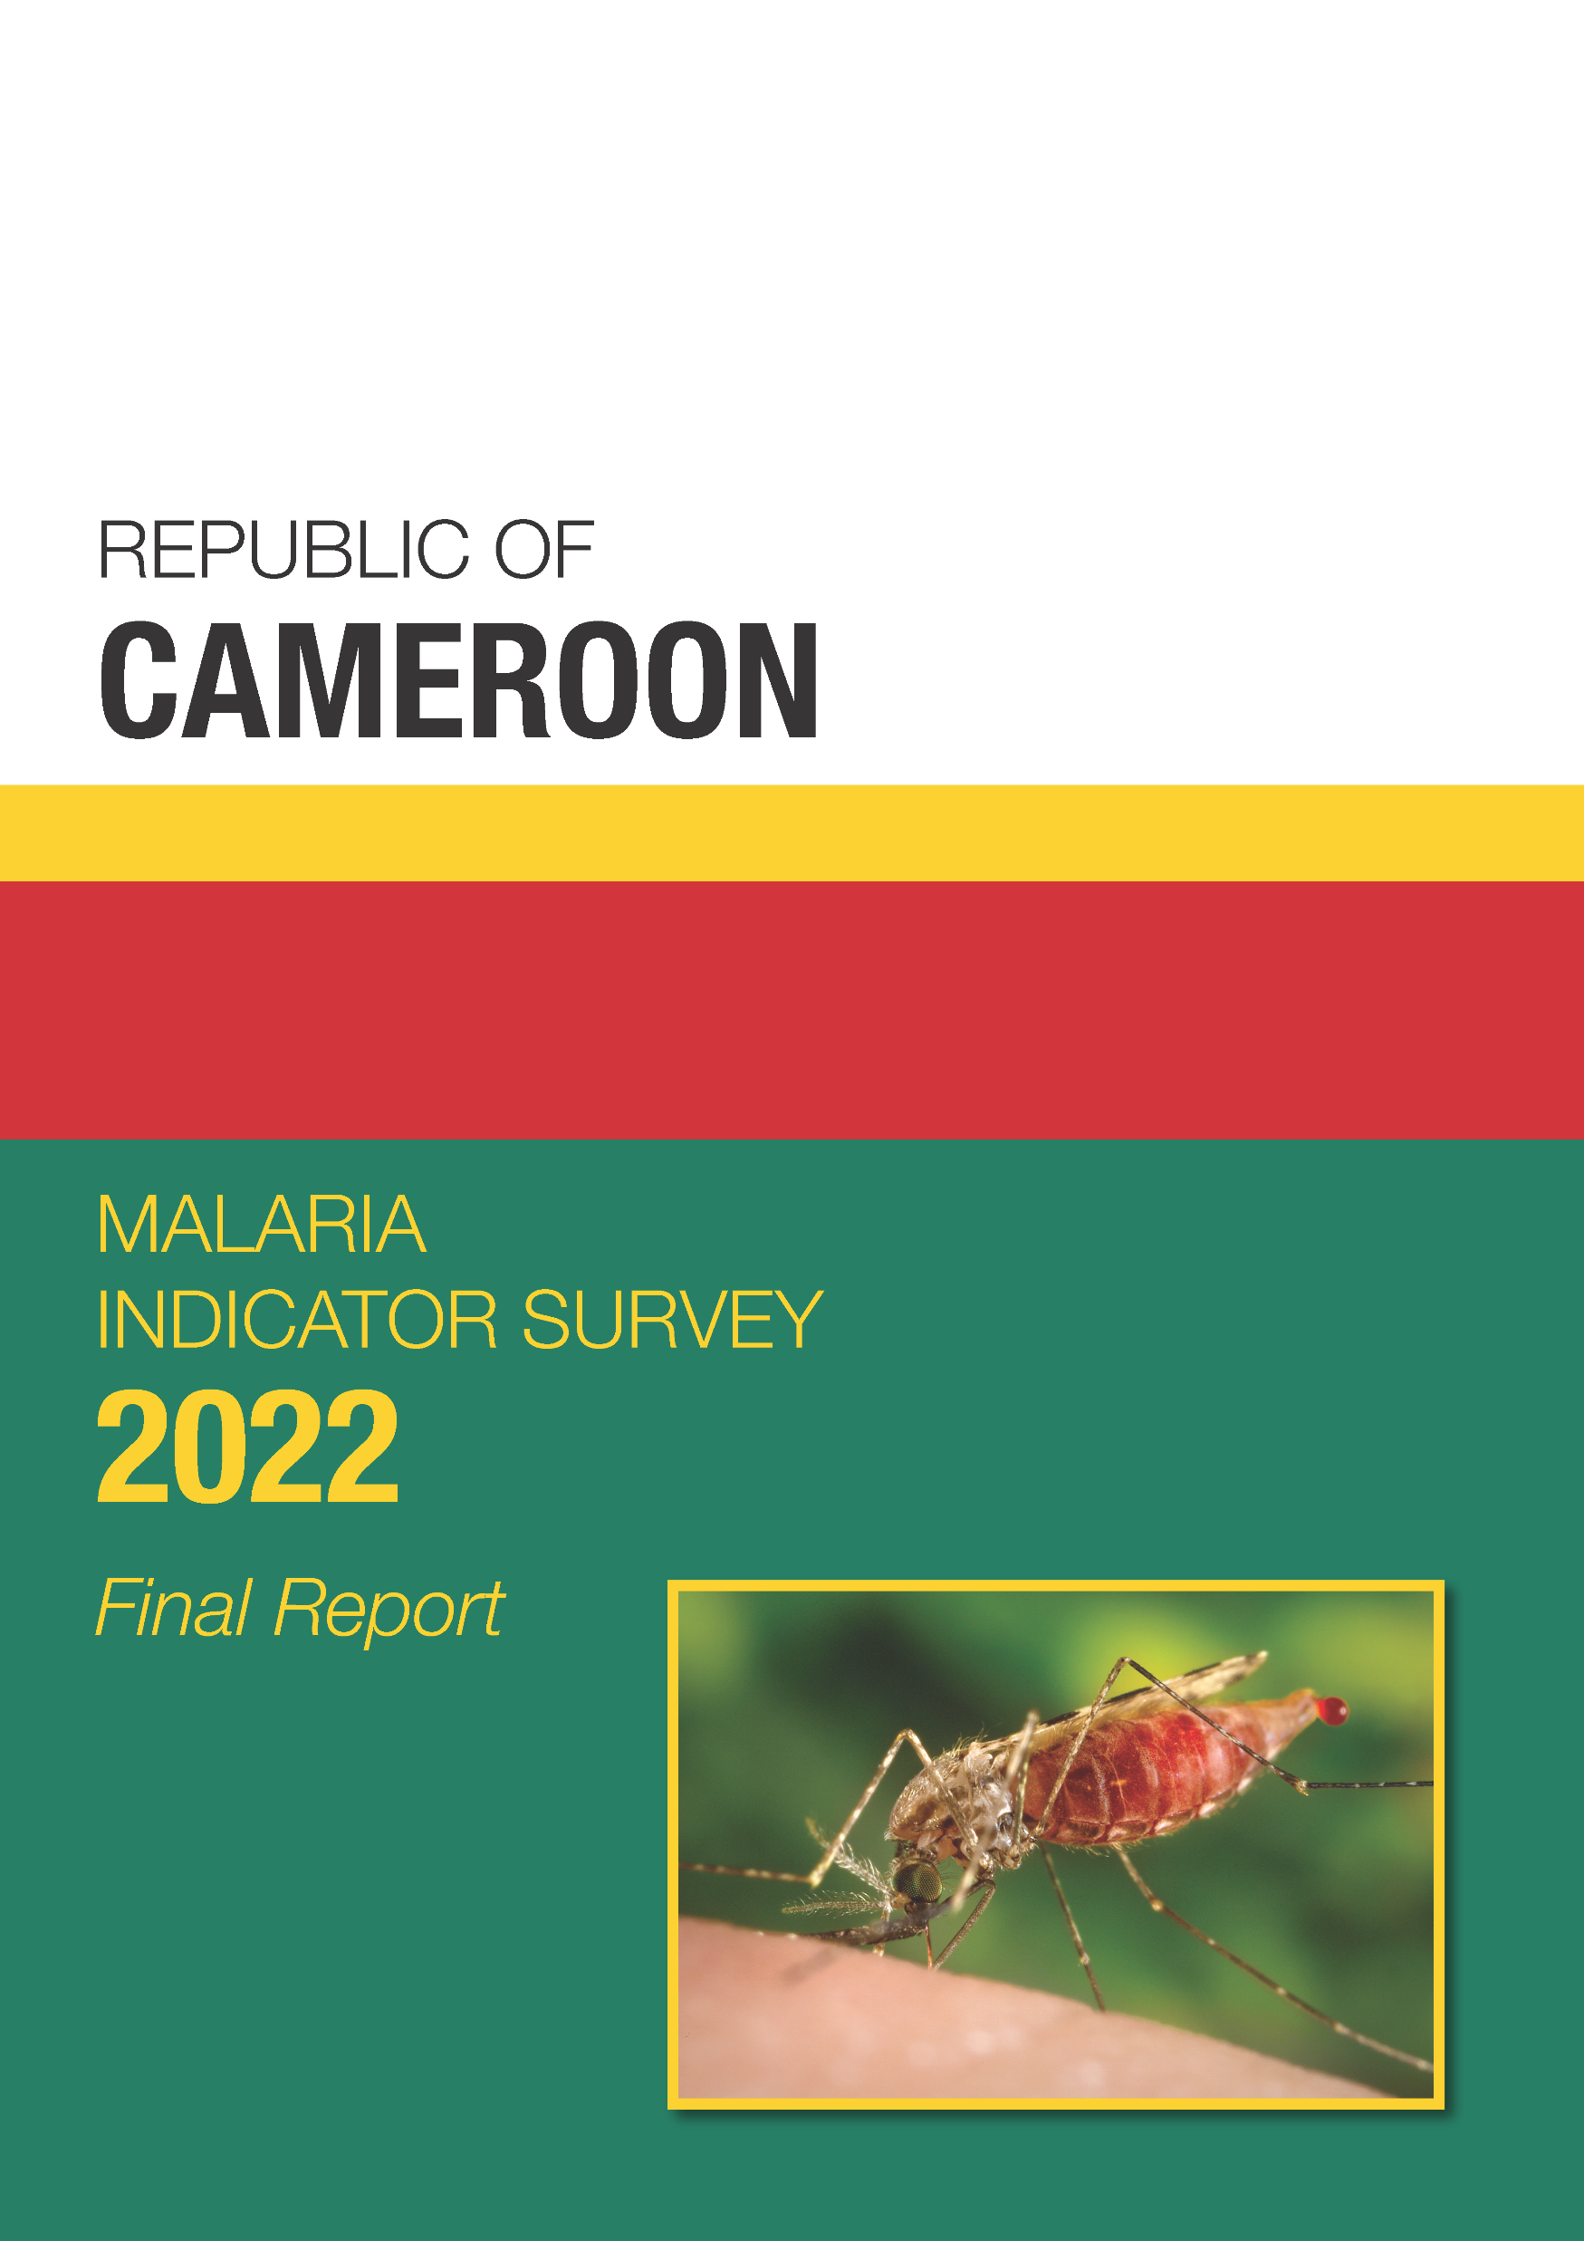
Case management of fever in children
Prevalence of low haemoglobin
Prevalence of malaria
Find these data in Chapter 4 of the Final Report

Slide 3
Fever in Children
Percent of children under age 5 with fever in the 2 weeks before the survey
Percent of children under age 5
Notes:
1 in 3 children under age 5 had fever in the 2 weeks before the survey; advice or treatment was sought for half of those children and blood was for testing from about 1 in 4 of those children.
Table 4.1

Slide 4
Type of Antimalarial Drugs
Among children under age 5 with fever in the 2 weeks before the survey who took an antimalarial, percent who took:
Notes:
Of children under age 5 with fever in the 2 weeks before the survey, nearly half took any ACT.
Table 4.8

Slide 5
Case management of fever in children
Prevalence of low haemoglobin
Prevalence of malaria
Find these data in Chapter 4 of the Final Report

Slide 6
Testing Coverage Rates
Percent of eligible children age 6-59 months tested for:
Notes:
Nearly all eligible children were tested for anaemia and malaria.
Table 4.9

Slide 7
Prevalence of Low Haemoglobin in Children by Age
Percent of children age 6-59 months with moderate-to-severe anaemia (haemoglobin < 8.0 g/dl)
Age in months
Notes:
Overall, 6% of the children tested had low hemoglobin. Children at 12-17 months had the highest prevalence at 11%.
Table 4.10

Slide 8
Prevalence of Low Haemoglobin by Region
Percent of children age 6-59 months with moderate-to-severe anaemia (haemoglobin < 8.0 g/dl)
Cameroon
6%
Far North 10%
North 9%
Northwest 1%
Adamawa 8%
Southwest 11%
West 1%
Centre 5%
Littoral 6%
Douala 1%
East 3%
Yaoundé 2%
South 5%
Notes:
The Far North (10%), North (9%) and South-West (11%) regions have the highest percentages of children with low haemoglobin. In contrast, the West (1%), North-West (1%), East (3%) and the cities of Douala (1%) and Yaoundé (2%) have the lowest prevalence.
Table 4.10

Slide 9
Prevalence of Low Haemoglobin by Wealth
Percent of children age 6-59 months with moderate-to-severe anaemia (haemoglobin < 8.0 g/dl)
Poorest households
Wealthiest households
Notes:
The prevalence of low haemoglobin is higher among children in the poorest households than among those in the wealthiest households.
Table 4.10

Slide 10
Trends in Prevalence of Low Haemoglobin
Percent of children age 6-59 months with moderate-to-severe anaemia (haemoglobin < 8.0 g/dl)
Notes:
The prevalence of low haemoglobin among children has declined from 2004 (11%) to 2022 (6%).

Slide 11
Case management of fever in children
Prevalence of low haemoglobin
Prevalence of malaria
Find these data in Chapter 4 of the Final Report

Slide 12
Malaria Prevalence by Age
Percent of children age 6-59 months who tested positive for malaria by rapid diagnostic test (RDT)
Age in months
Notes:
1 in 4 children tested positive for malaria. Prevalence increases from the age of 24 months.
Table 4.11

Slide 13
Malaria Prevalence by Residence
Percent of children age 6-59 months who tested positive for malaria by RDT
Notes:
In Yaoundé and Douala, the prevalence is only 8%, but in the rural regions, 1 of 3 children tested positive.
Table 4.11

Slide 14
Prevalence of Malaria by Region
Percent of children age 6-59 months who tested positive for malaria by RDT
Cameroon
26%
Far North 27%
North 29%
Northwest 11%
Adamawa 31%
Southwest 30%
West 19%
Centre 49%
Littoral 28%
East 41%
Douala 7%
Yaoundé 10%
South 46%
Notes:
The regions with the percent of children who tested positive for malaria are highest in Centre (49%), South (46%), and East (41%).
Table 4.11

Slide 15
Malaria Prevalence by Wealth
Percent of children age 6-59 months who tested positive for malaria by RDT
Poorest households
Wealthiest households
Notes:
Malaria prevalence is highest among those in the poorest households and lowest among those in the wealthiest households.
Table 4.11

Slide 16
Trends in Malaria Prevalence
Percent of children age 6-59 months who tested positive for malaria by RDT
Notes:
Malaria prevalence remained stable from 2018 to 2022, after having dropped between 2011 and 2018.
Table 4.11

Slide 17
Key Findings
27% of children under 5 with fever in the 2 weeks before the survey had blood taken from a finger of heel for testing.
6% of children age 6-59 months have low haemoglobin.
26% of children age 6-59 months tested positive for malaria by RDT.

